Slide 1
Experiments in Integrated Data Center Power and Cooling Analysis
Shaun Brandt, Hema Kumar, Michael Novak, Mandar Patil, Yu Yang
Portland State University

Slide 2
About the project
The need for large scale computing continues to rise, and companies are turning to data centers to meet those needs
Large clusters of servers are expensive to run, and expensive to cool
Cooling devices (especially chillers) consume lots of power and are subject to physical wear
Data center operators need access to as much information as possible!

Slide 3
About the data
Data for this project was collected from a number of sensors at the PNNL Energy Smart Data Center
8 server racks (1 network, 2 air cooled, 5 liquid cooled)
Two application loads (high density / low density)
Three different application test runs

Slide 4
Approach 1: Analysis with Scripts
A set of custom tools was written to work with sensor data provided in CSV format
Mostly Haskell with calls to Gnuplot (earlier prototypes also used C, Perl and shell)
Generates a complete report including tables and graphs
Calculates and graphs metrics such as temperature deltas, COP (coefficient of performance) and power usage

Slide 5
Analysis with Scripts (cont.)
Cluster analysis based on output of metric calculations
Our work uses ELKI, an open source data mining tool with many customizable options (such as choice of clustering algorithms)
We tried clustering on various metrics, including chiller water temperature deltas, coefficient of performance (COP) and cooling load
We developed a method to overlay cluster information over previously generated graphs

Slide 6
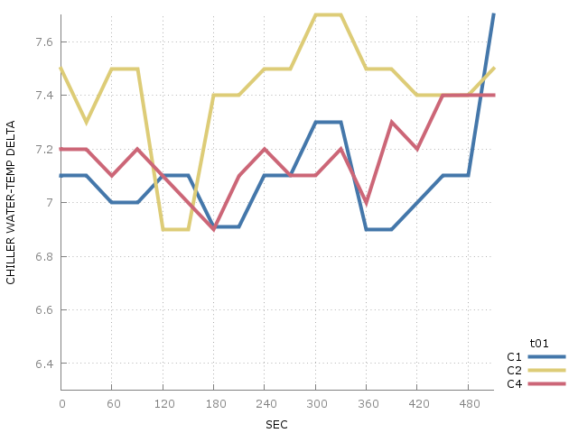
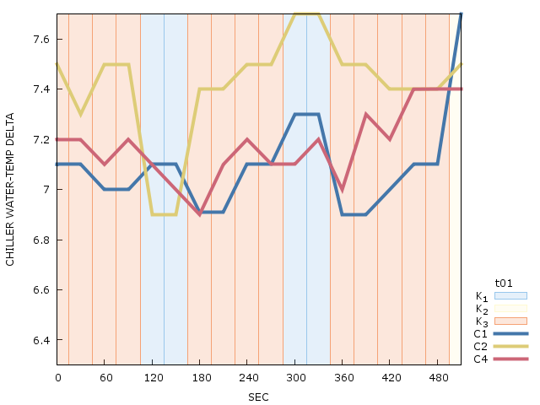
Time-correlated cluster charts
On the left – low density chiller temperature delta chart
On the right – the associated time-correlated chart

Slide 7
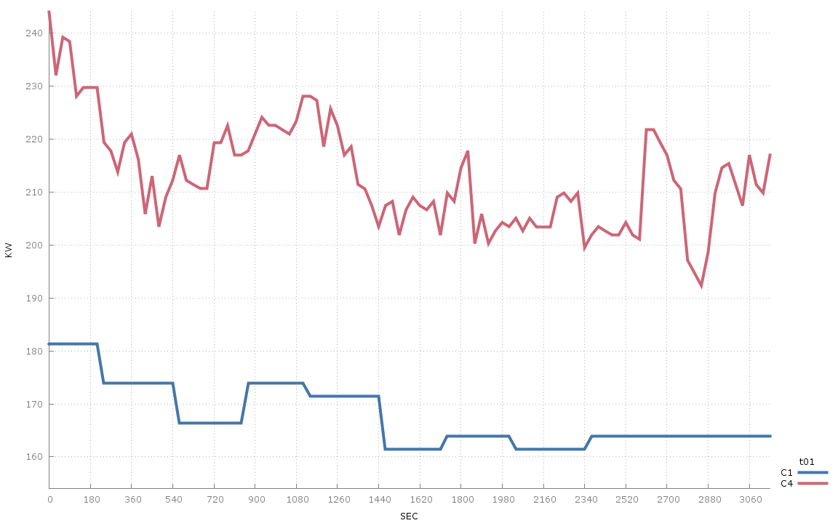
Chiller Power (KW) chart, HD data

Slide 8
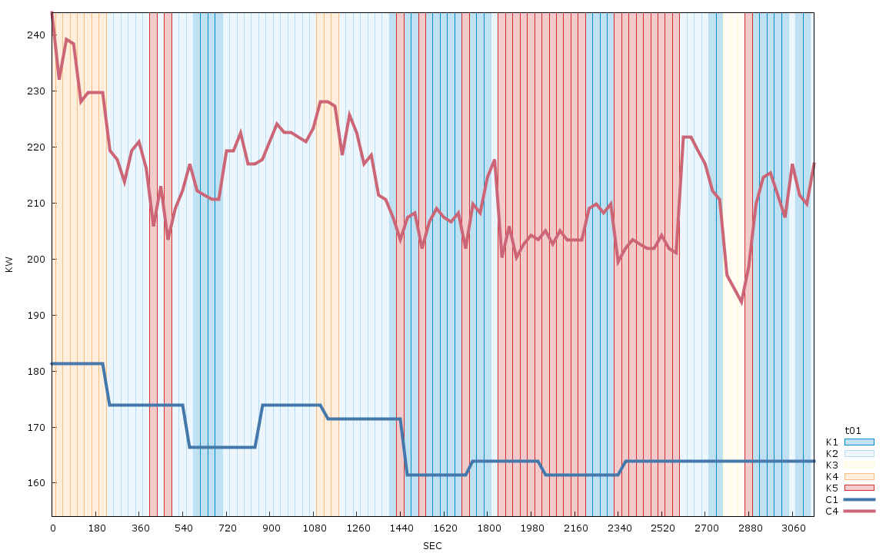
Associated time-correlated cluster chart

Slide 9
Approach 2: Perftrack Modifications

Slide 10
Perftrack Modifications (cont.)

Slide 11
Limitations / Future work
Need more (and more accurate) data!
Full integration of script work into Perftrack
Modification of scripts to support direct connection to FRED in place of CSV file access
Experiment with motif-based cluster analysis (this would require more data)

